Slide 1
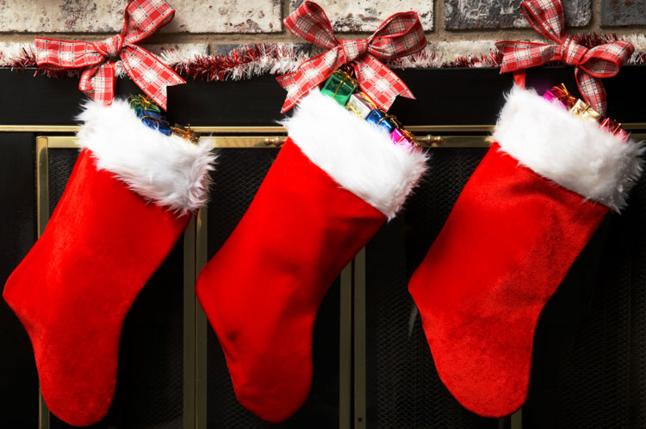
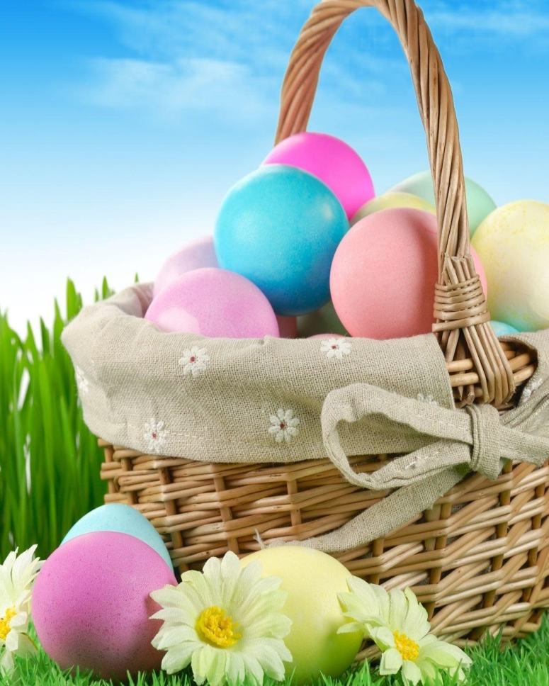
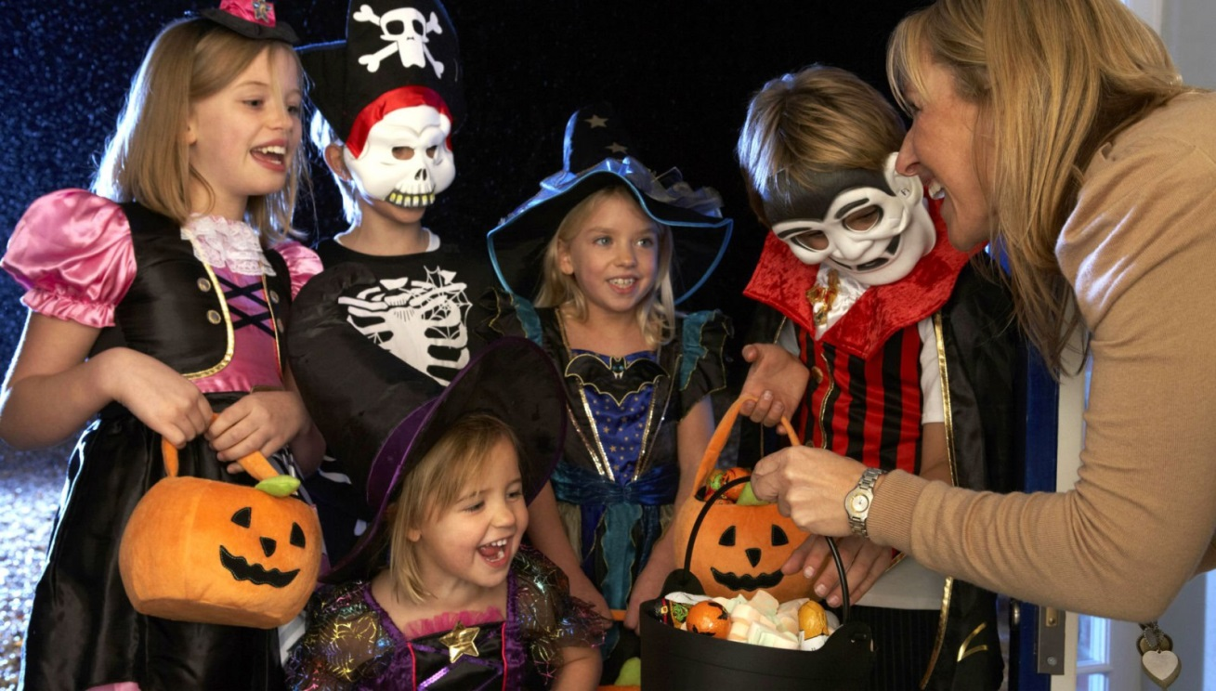
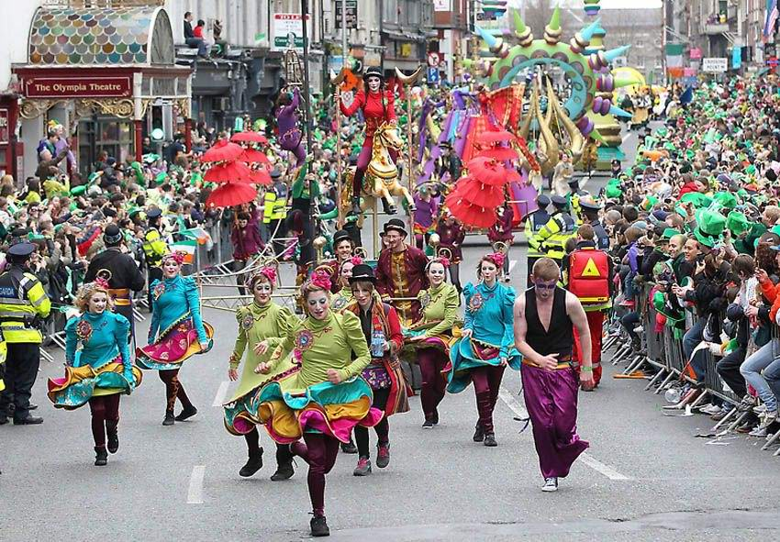
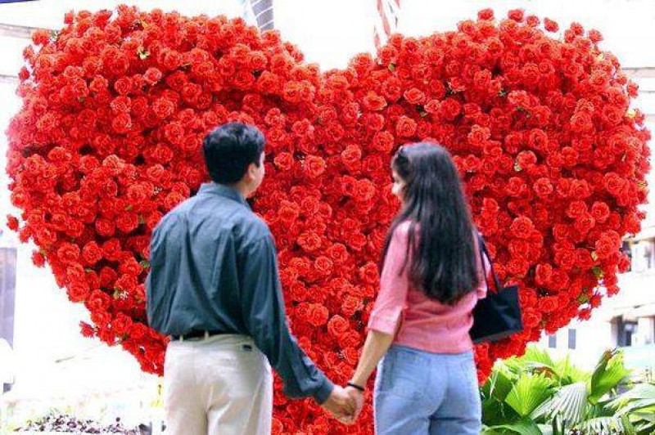
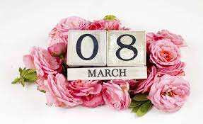

Slide 2
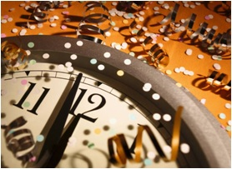
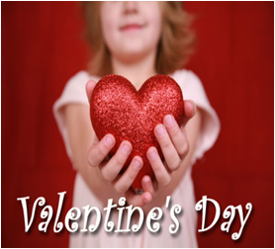
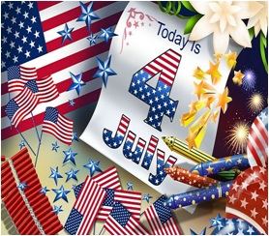
New Year’s Day (1st of January)
St. Valentine’s day (14th of February)
Easter (March-April)
Halloween (31th of October)
Christmas (25th of December)
Women’s day (8th of March)

Slide 3
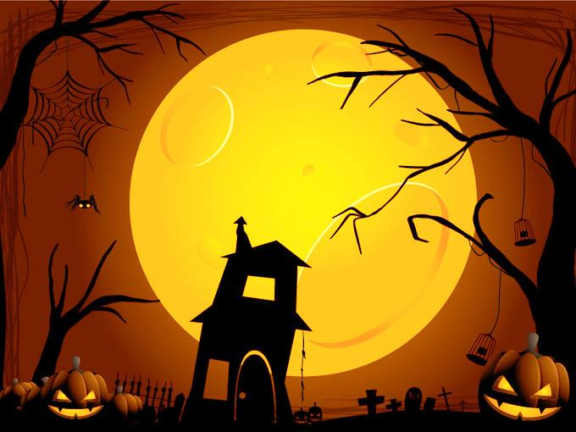
What do you know about Halloween?
Do you know why pumpkin is the symbol of this holiday?
What are the symbols of Halloween?
What is Jack-o'-lantern?
HOLIDAY
What do people do on Halloween?
What are Halloween’s sweets?

Slide 4
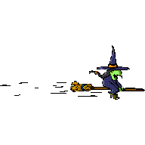
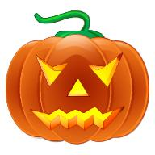
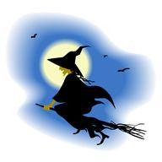
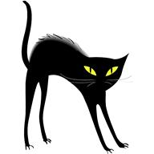
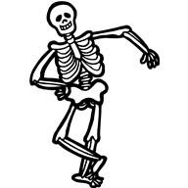
Halloween has its own
symbols. They are…
A SMILING JACK
OR
JACK’ O’ LANTERN
A SCELETON
A WITCH ON A BROOM
A BLACK CAT
A GHOST

